Slide 1

Ontologies 2
November 9, 2018
Andrew Post
Department of Biomedical Informatics, Emory University, Atlanta, GA USA
Department of Biomedical Engineering, Georgia Institute of Technology, Atlanta, GA, USA

Slide 2
Ontologies Agenda
Lecture 1: Storing knowledge
Homework 1: Analysis of ICD10-to-9 and ICD9-to-10 mappings
Lecture 2: Acquiring knowledge
Homework 2: Improving the ICD10-to-9 mapping

Slide 3
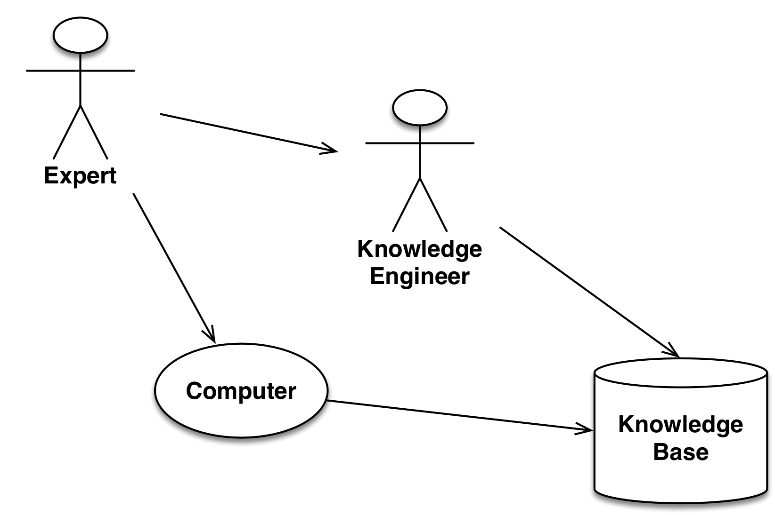
Two Views of Knowledge Acquisition

Slide 4
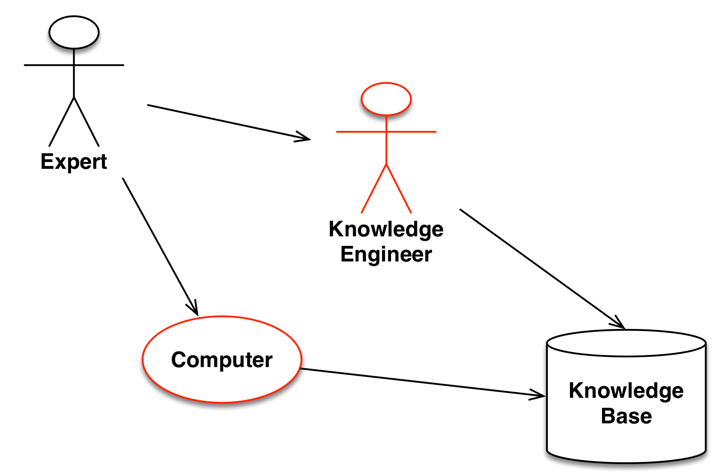
Two Views of Knowledge Acquisition
Knowledge Engineer
A computer specialist trained in acquiring knowledge from subject matter (i.e., domain) experts and encoding it in computable form
Computer
Assists the knowledge engineer
Works autonomously using machine learning

Slide 5
The Knowledge Acquisition Problem
Knowledge bases comprise models of systems in the world
Experts can solve problems without having explicit models
What experts articulate may be
Insufficient for problem solving, either by humans or by computers
Often irrelevant, and possibly erroneous, for describing their own problem solving
Explicit models provide a “scaffolding” that may enhance the ability of experts to articulate what they know

Slide 6
The Nature of Elicited Knowledge
Two classes of problem-solving knowledge
Reconstructed “Textbook” techniques – do not always work in practice
Authentic Behaviors actually used by experts
Reconstructed methods may be invented by experts and knowledge engineers to fill gaps in the knowledge that experts can articulate

Slide 7
But Do We Want Authentic Anyway?
Human cognition is subject to recognized biases, for example
Anchoring: the tendency to rely too heavily on an initial piece of information when making a decision
Availability: the tendency to think that examples of things that come readily to mind are more representative than is actually the case
Representativeness: the tendency to estimate the likelihood of an event by comparing it to an existing prototype that already exists in our minds
Normative methods
Yield provably “correct” results, given a set of axioms
May not demonstrate explainable behaviors
May not behave as human experts might expect

Slide 8
Knowledge Acquisition Techniques Examining Text Sources
Generally is easy and inexpensive
Facilitates understanding of the domain vocabulary
Primarily may yield background knowledge rather than the knowledge required to solve specific cases
Requires disambiguation of natural language
Provides reconstructed reasoning strategies, not authentic methods

Slide 9
Knowledge Acquisition Techniques Direct Questioning
Requires skill in posing non-biasing, non-threatening, open-ended questions
May cause expert to distort responses due to
Cognitive biases
Desire to please the questioner
Desire to offer socially acceptable responses
Desire to simplify explanations
Desire to hurry up and get on with the interview
May yield reconstructed knowledge that does not work in practice

Slide 10
Knowledge Acquisition Techniques Protocol Analysis
“Thinking aloud” session in which expert solves specific cases in a laboratory settings
Identifies
Stimuli to which subject attends during problem solving
Sequence of problem solving steps
Minimizes bias that is introduced
By the knowledge engineer (who may ask poor direct questions)
By the subject (who may distort her responses, e.g., to please or simplify)
Requires analysis of a sufficient number of cases
Like all approaches that require introspection, may lead to reconstructed knowledge

Slide 11
Knowledge Acquisition Techniques Discourse Analysis
Ethnographic observation of experts in “field” settings
Cases solved are those that arise normally in practice
Problem-solving strategies are inferred by observing subjects’ actual behaviors
Observers face considerable problems in determining which utterances and which stimuli are relevant
Unclear how to predict those situations in which theoretical benefits justify enormous cost

Slide 12
Knowledge Acquisition Techniques Psychometric Techniques
Standardized interviewing methods determine entities in the domain and attributes of those entities
Standardized statistical procedures determine (possibly covert) relationships among entitites and attributes

Slide 13
Knowledge Acquisition Techniques Semi-automated Techniques
Specialized software is used to construct a scaffolding or ontology to guide knowledge engineers and/or experts in providing knowledge
Protégé (http://protege.stanford.edu)

Slide 14
Knowledge Acquisition Techniques Fully-automated Techniques
Logging software can find common patterns of data access and use of an information system
Machine learning can uncover unexpected correlations between diseases and findings
Information theoretic approaches of analyzing medical texts to discover relationships between diseases and findings
Data mining can uncover unexpected practice patterns

Slide 15
Ontologies Homework #2
Download the 2015 California State ICD9 diagnosis code volume file from https://data.chhs.ca.gov/dataset/hospital-inpatient-diagnosis-procedure-and-external-cause-codes/resource/6e320cac-26ba-42d9-870a-fada82f66600.
Read the documentation.
Convert the file to a plain text format.
Implement using python 3.6 an algorithm of your own design that uses the above code volume file to convert as many ICD10-to-ICD9 1:many mappings as possible into 1:1 mappings.
In a 1-page document, describe the algorithm that you created, quantify the reduction in 1:many mappings, and justify your algorithmic choices.
The program must accept command line arguments for the paths to the data files that are required. You must document the command line arguments.
The program must be runnable in Anaconda. If I cannot easily run your program with zero modifications after reading your documentation, I will take points off.
Put your Python program, a README describing how to run it, and a document with the above descriptions of your algorithm in your github repo and share it with me (github username arpost).
Due date to complete the assignment and share it with me is November 15 at 11:59:59pm. Do not modify your project after this date and time until I have graded it.

